Slide 1

PSYLIQ INTERNSHIP
DATA ANALYST

Slide 2

HR DATA ANALYSIS

Slide 3
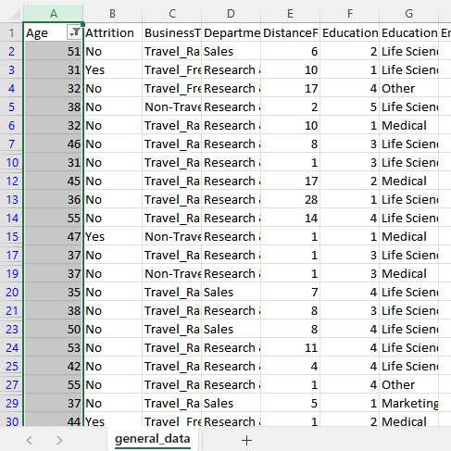
1. Using Excel, how would you filter the dataset to only show employees aged 30 and above?

Slide 4
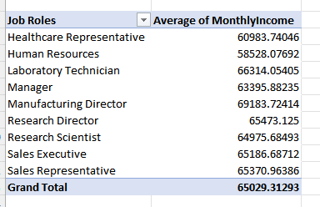
2. Create a pivot table to summarize the average Monthly Income by Job Role.

Slide 5
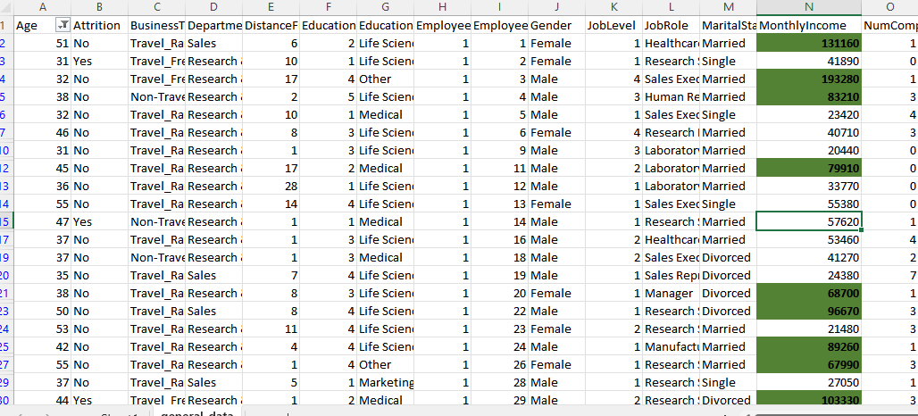
3. Apply conditional formatting to highlight employees with Monthly Income above the company's average income.

Slide 6
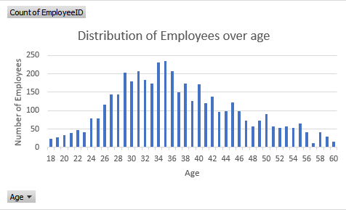
4. Create a bar chart in Excel to visualize the distribution of employee ages.

Slide 7
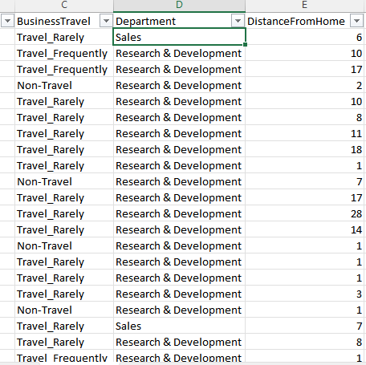
5. Identify and clean any missing or inconsistent data in the "Department" column.
The Department column is complete and consistent.

Slide 8
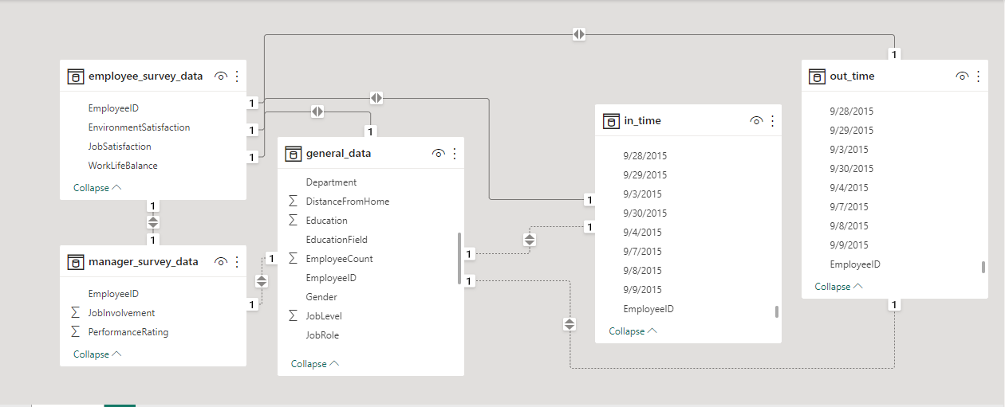
6. In Power BI, establish a relationship between the "EmployeeID" in the employee data and the "EmployeeID" in the time tracking data.

Slide 9
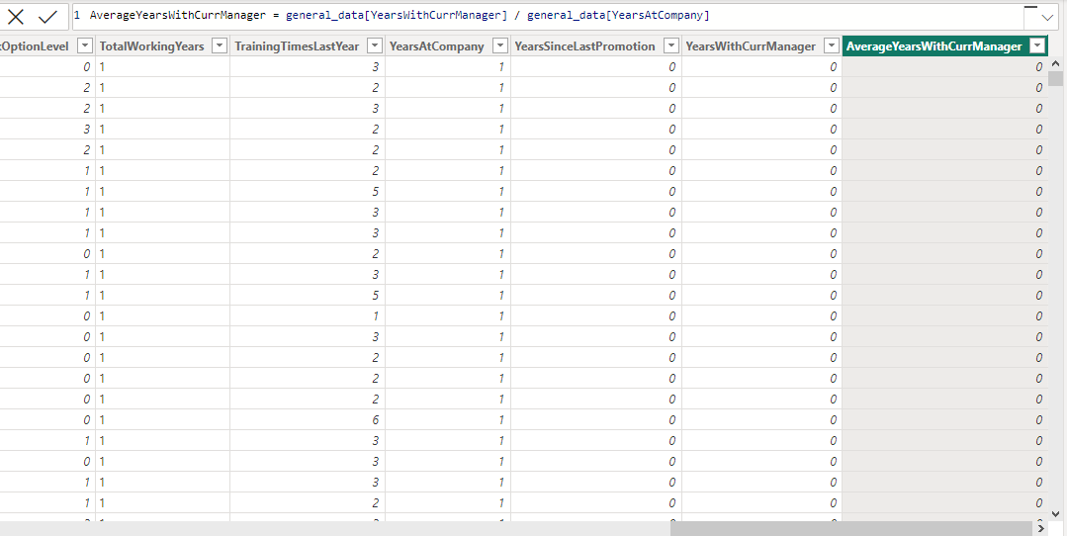
7. Using DAX, create a calculated column that calculates the average years an employee has spent with their current manager.

Slide 10
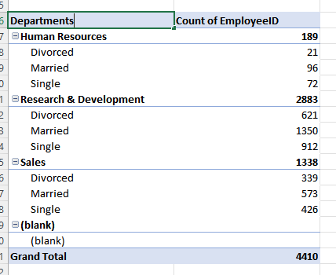
8. Using Excel, create a pivot table that displays the count of employees in each Marital Status category, segmented by Department.

Slide 11
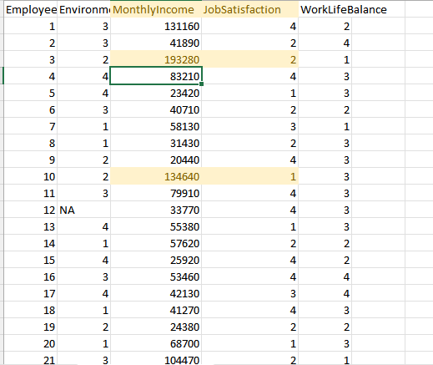
9. Apply conditional formatting to highlight employees with both above-average Monthly Income and above-average Job Satisfaction.

Slide 12
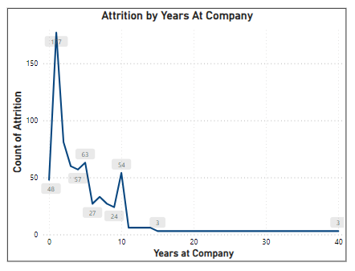
10. In Power BI, create a line chart that visualizes the trend of Employee Attrition over the years.

Slide 13
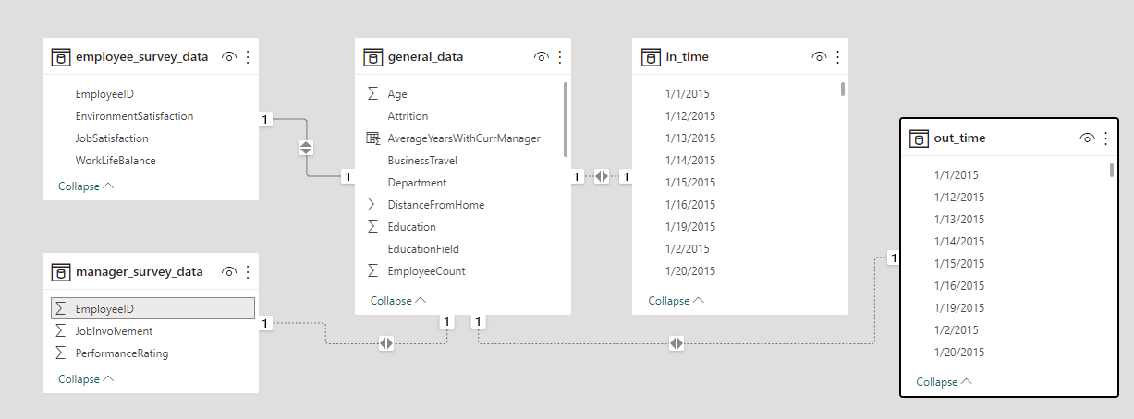
11. Describe how you would create a star schema for this dataset, explaining the benefits of doing so.
The star schema is a database modeling technique that organizes data into a central "fact" table surrounded by "dimension" tables. This design offers several benefits:
Simplicity and Understandability.
Performance.
Efficient Aggregation.
Scalability.
Easier maintenance.

Slide 14
12. Using DAX, calculate the rolling 3-month average of Monthly Income for each employee.
Rolling 3-Month Average =
VAR CurrentEmployee = EmployeeIncome[EmployeeID]
VAR CurrentDate = EmployeeIncome[Date]
RETURN
AVERAGEX(
FILTER(
ALL(EmployeeIncome),
EmployeeIncome[EmployeeID] = CurrentEmployee &&
EmployeeIncome[Date] <= CurrentDate &&
EmployeeIncome[Date] > EDATE(CurrentDate, -3)
),
EmployeeIncome[MonthlyIncome]
)

Slide 15
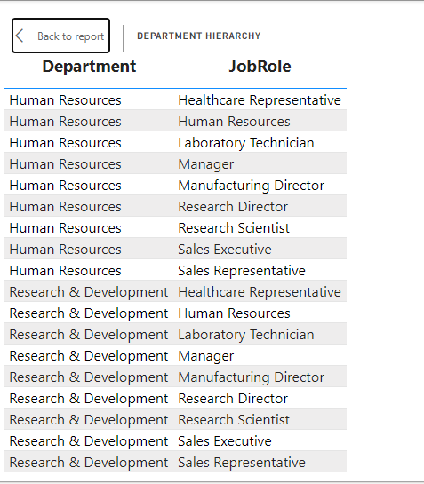
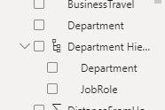
13. Create a hierarchy in Power BI that allows users to drill down from Department to Job Role to further narrow their analysis.

Slide 16
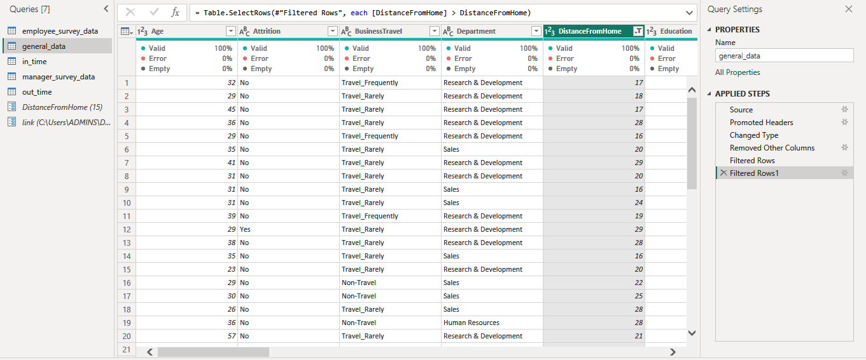
14. How can you set up parameterized queries in Power BI to allow users to filter data based on the Distance from Home column?

Slide 17
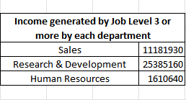
15. In Excel, calculate the total Monthly Income for each Department, considering only the employees with a Job Level greater than or equal to 3.

Slide 18
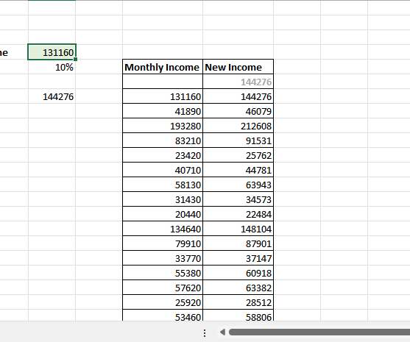
16. Explain how to perform a What-If analysis in Excel to understand the impact of a 10% increase in Percent Salary Hike on Monthly Income.

Slide 19
17. Verify if the data adheres to a predefined schema. What actions would you take if you find inconsistencies?
The data adheres to a predefined schema. Some of the actions we can take are:
Document: Record details of the inconsistencies.
Identify Source: Find where issues originate.
Data Profiling: Analyze data quality, patterns.
Validate Source: Compare with original systems.
Cleanse Data: Remove duplicates, correct errors.

Slide 20
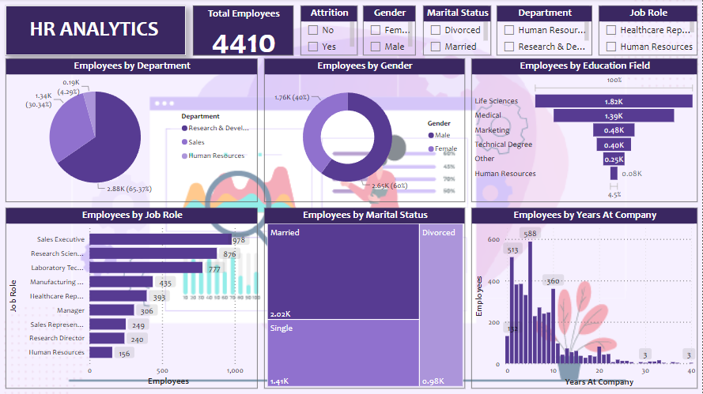

Slide 21
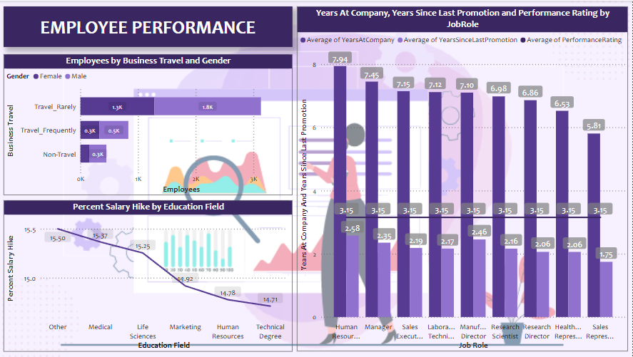

Slide 22
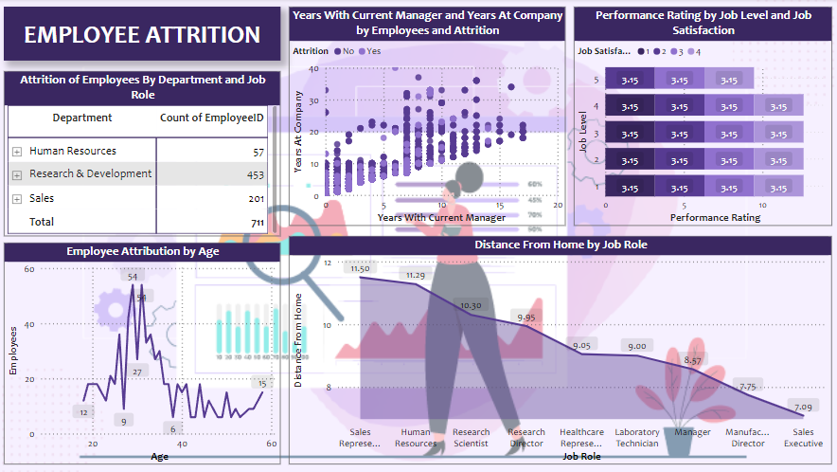

Slide 23
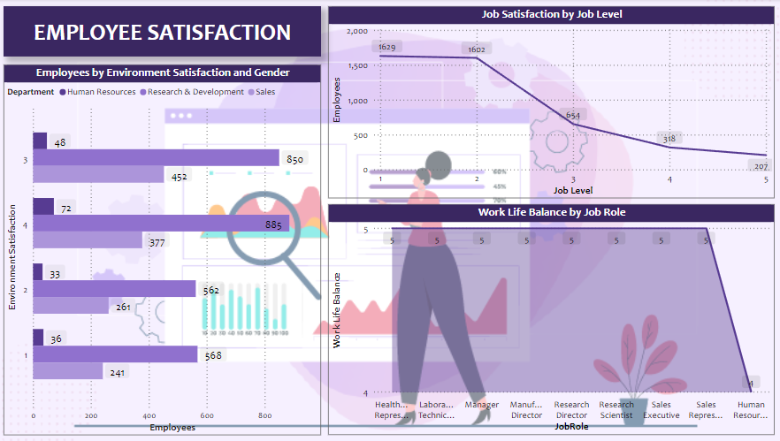

Slide 24

THANK YOU

